Slide 1


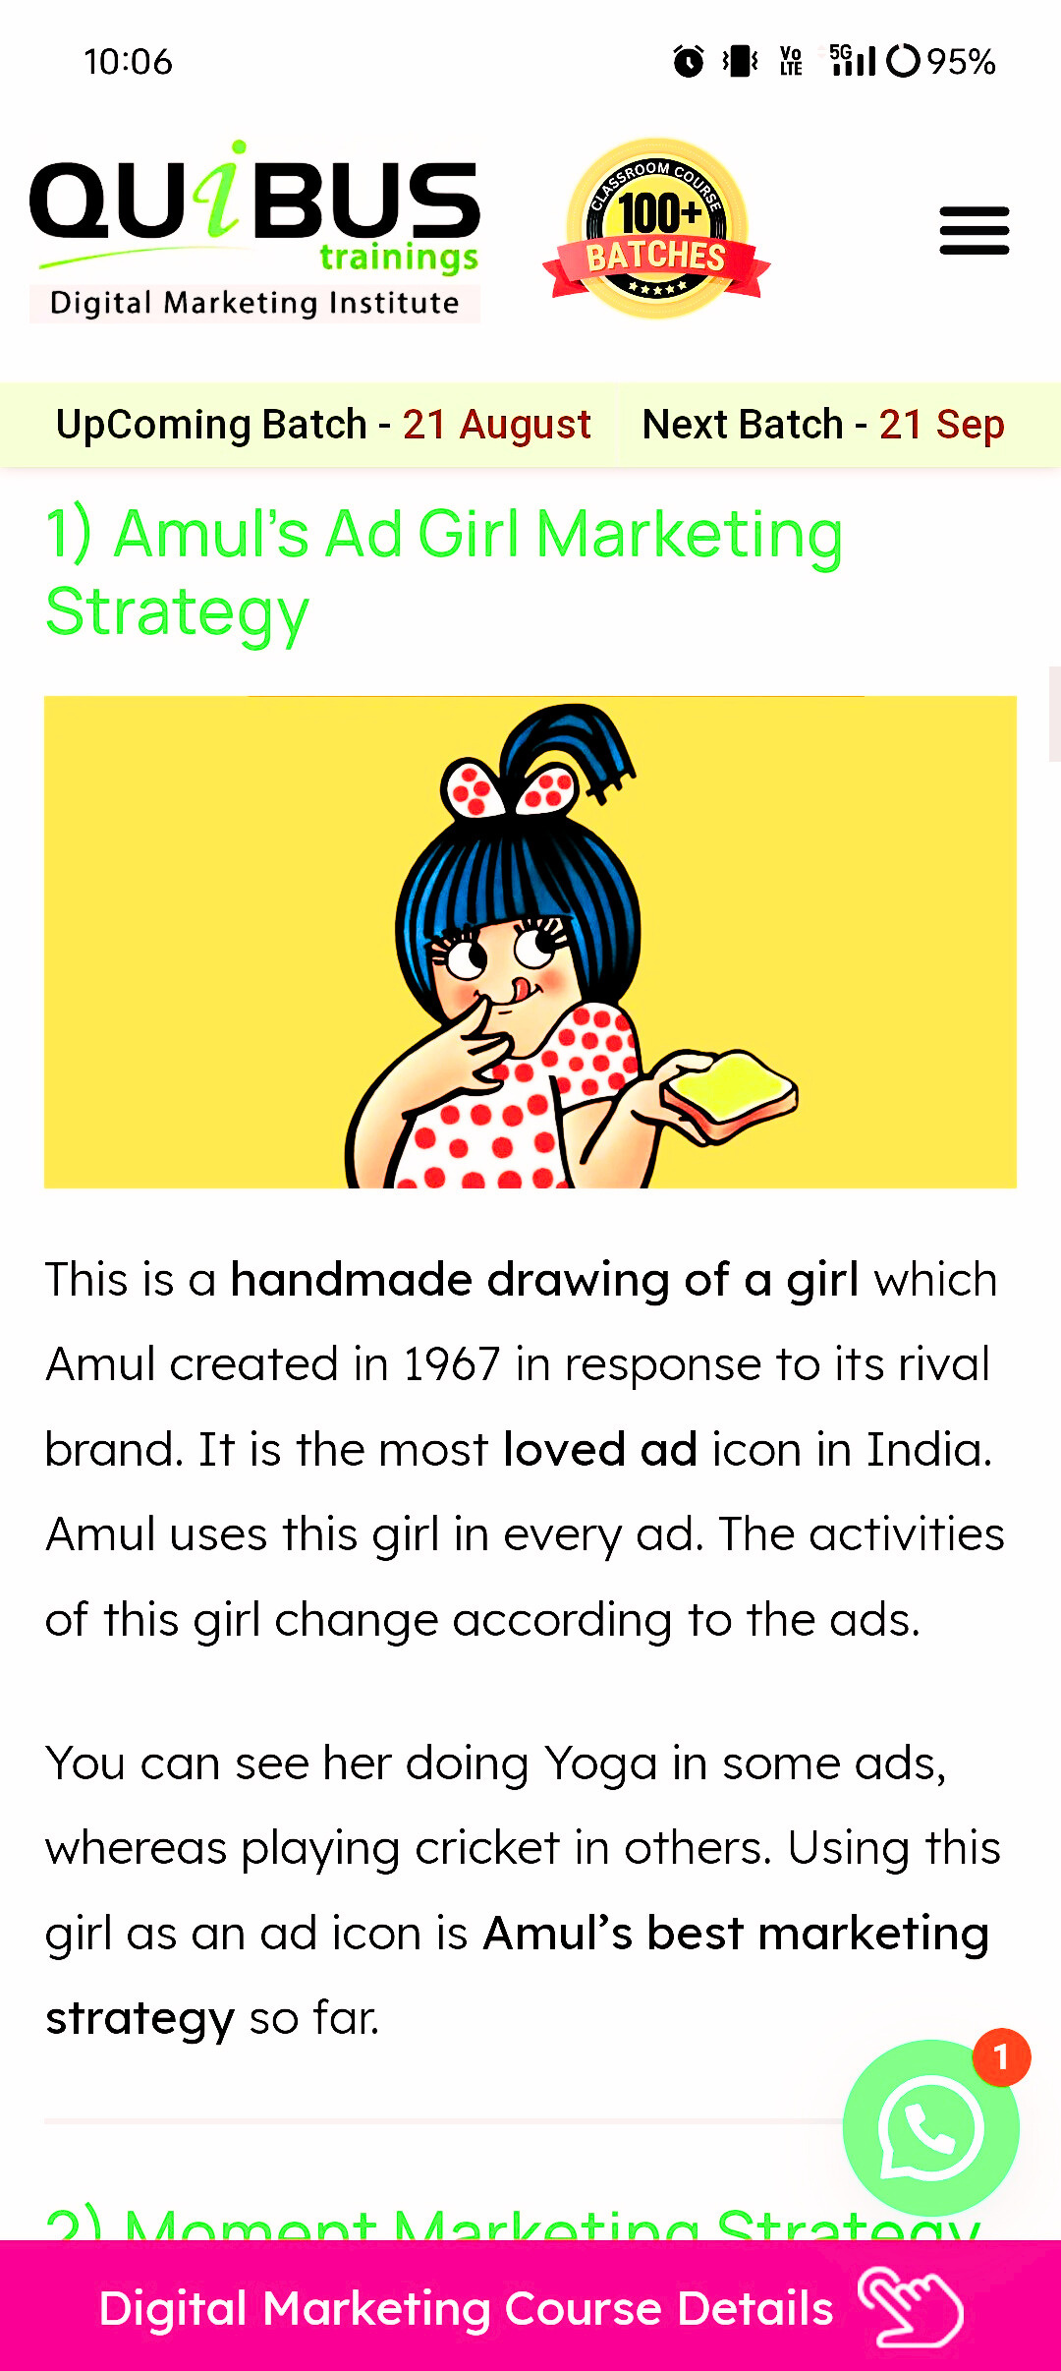

Amul
-The Taste Of India-
OUR TEAM
Team lead: Bhimuni Vineetha Rao
Team member: Edadasari Helen Zaneta
Team member: Vasupalli Keerthana
Team member: Angel Prescilla Joseph
Team member: Chelluri Jaswanth Mani Kumar
Team member :Doddi Manisha

Slide 2


Amul is an acronym(Anand Milk Union Limited)of the Indian Multinational cooperative society named Gujarat Milk Marketing Federation based in Anand,Gujarat.
It is under the ownership of Gujarat Cooperative Milk Marketing Federation Limited.
Tribhuvandas Kishibhai Patel founded the organisation in 1946 and served as its chairman until his retirement in the 1970s.
Amul spurred India's white revolution,which made the country the world's largest producer of milk and milk products,and has since ventured into overseas markets.

Slide 3
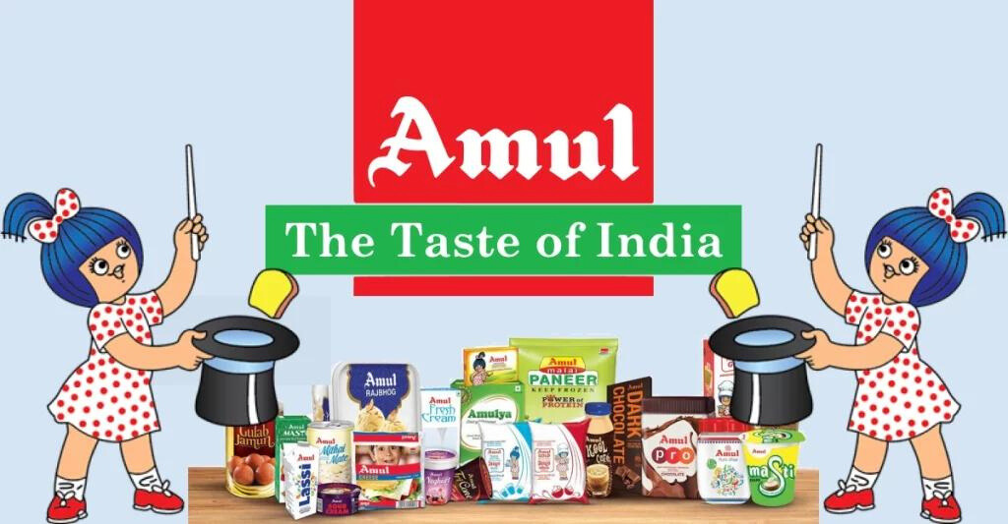

Brand Identity
The brand Identity of Amul is characterized by several key elements:
- Brand name & logo
-Tagline: The taste of India
-Amul Girl
-Product range
-Quality and trust
-Advertising and communication
-Heritage and legacy
-Strong distribution network
- Reliability and purity
-Sustainability and social responsibility
Amul's brand Identity is a blend of tradition, innovation,trust and social responsibility.It represents not just a product but a movement that has brought about a significant social change in India.

Slide 4
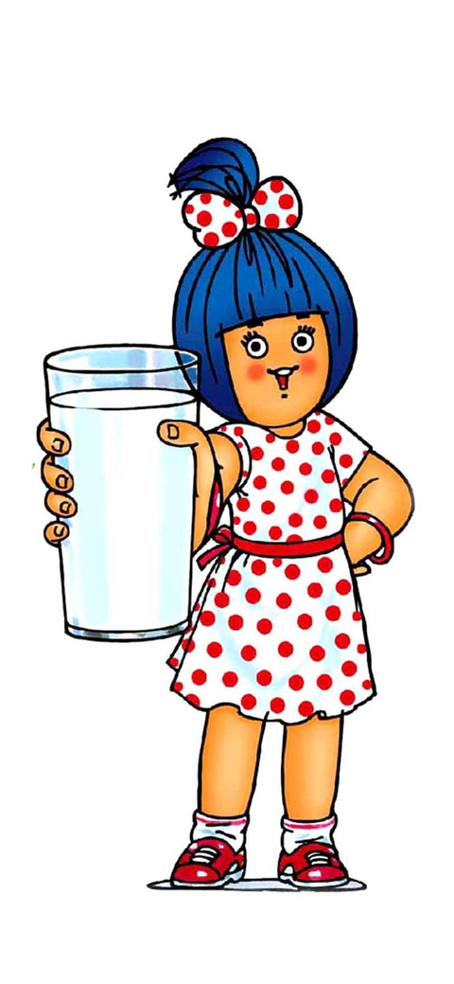

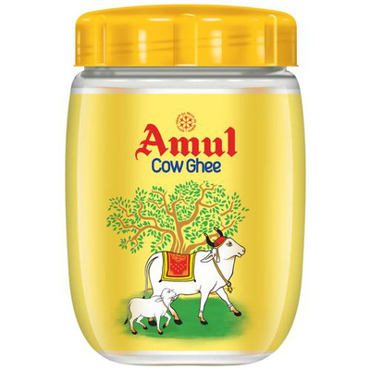
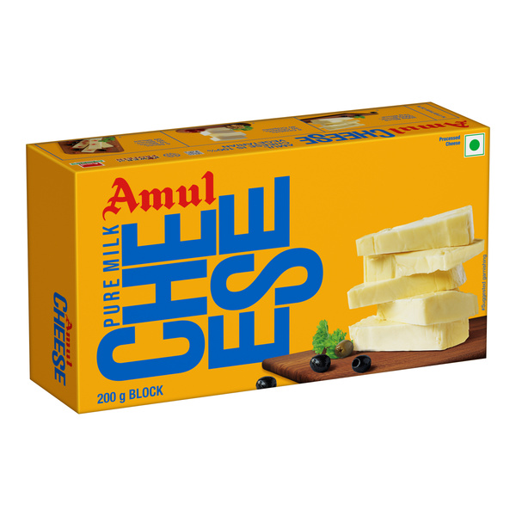
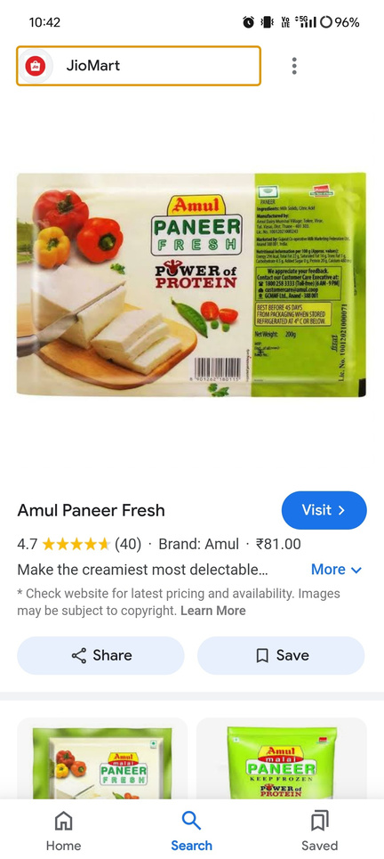
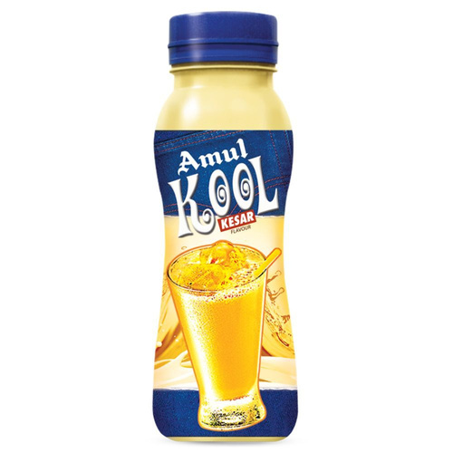
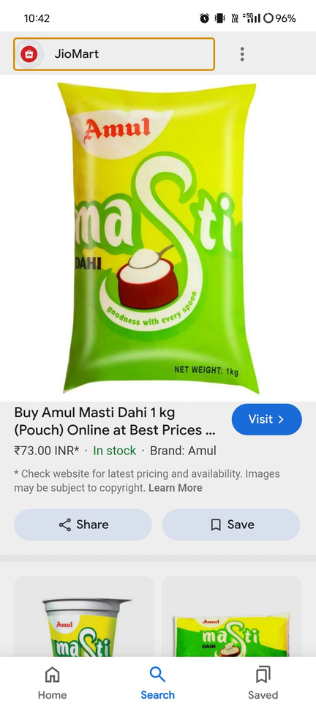

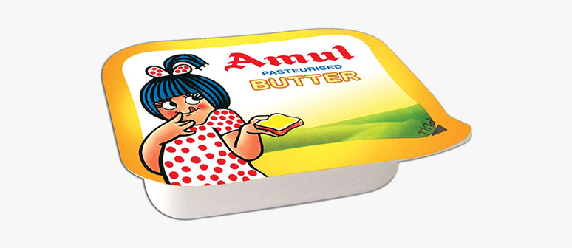
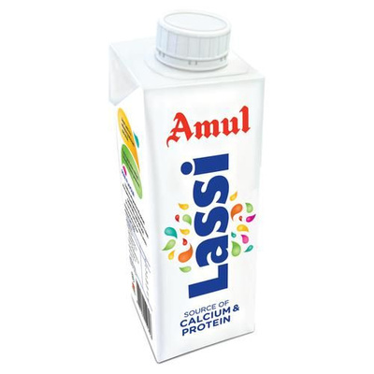
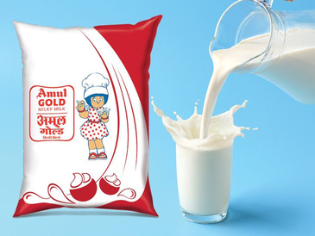
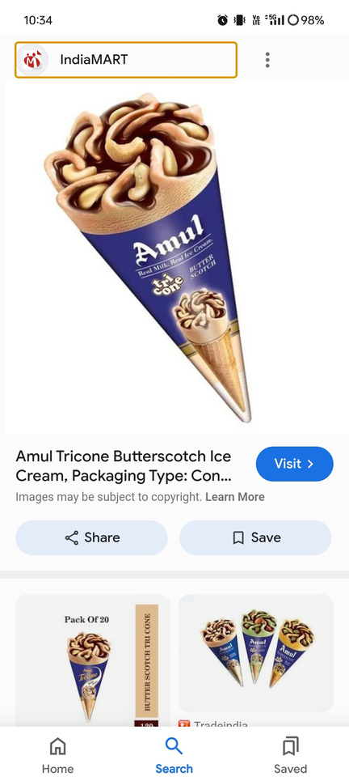
Key products manufactured by Amul
Amul Butter
Amul Ghee
Amul Milk
Amul Cheese
Amul Ice cream
Amul Paneer
Amul Milk Powder
Amul Chocolates
Amul milk beverages
Amul whipped cream

Slide 5


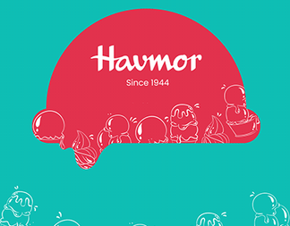
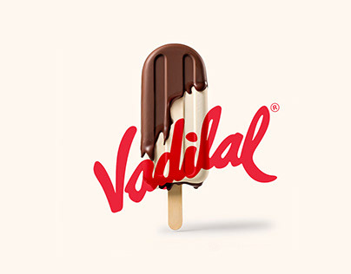



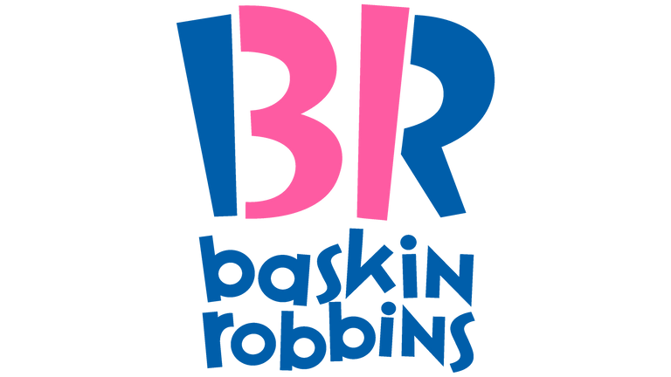
Competitor Analysis
Amul has many competitors, who has entered the market in last decade and are growing their market share steadily. In Ice cream category, Amul owns a major share but even though individually these competitor brands might not be a worthy adversary,combined and due to synergy, all of them together re giving very tough competition to Amul.
list of its top competitors:
•Kwalty walls
•Vadilal
•Havmore
•Dinshaws
•Baskin Robbins
•London Dairy
•Arun Ice cream
•Amul has a 4.5 times larger market share than its closest competitor.

Slide 6
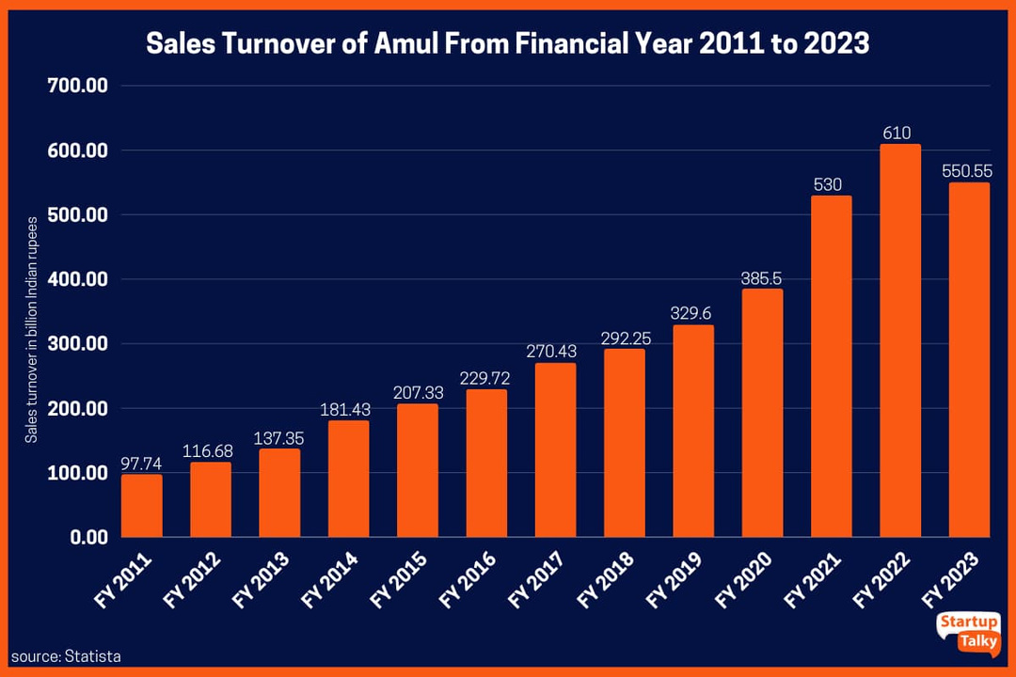

Here's a comparison of sales between Amul,Kwality walls and Vadilal ice cream brands:,
Amul
As of 2023,Amul reported sales of over 550 billion Indian rupees,boasting a 40% Market share in India.
Kwality Walls
Owned by Hindustan Unilever,Kwality walls reached a business of Rs 1,000 crore in 2022.
Vadilal
Vadilal is India's 2nd largest ice cream brand by sales and has a 16% Market share.In March 2023,Vadilal reported revenues of Rs 210 crore,a 20% increase from the previous year

Slide 7

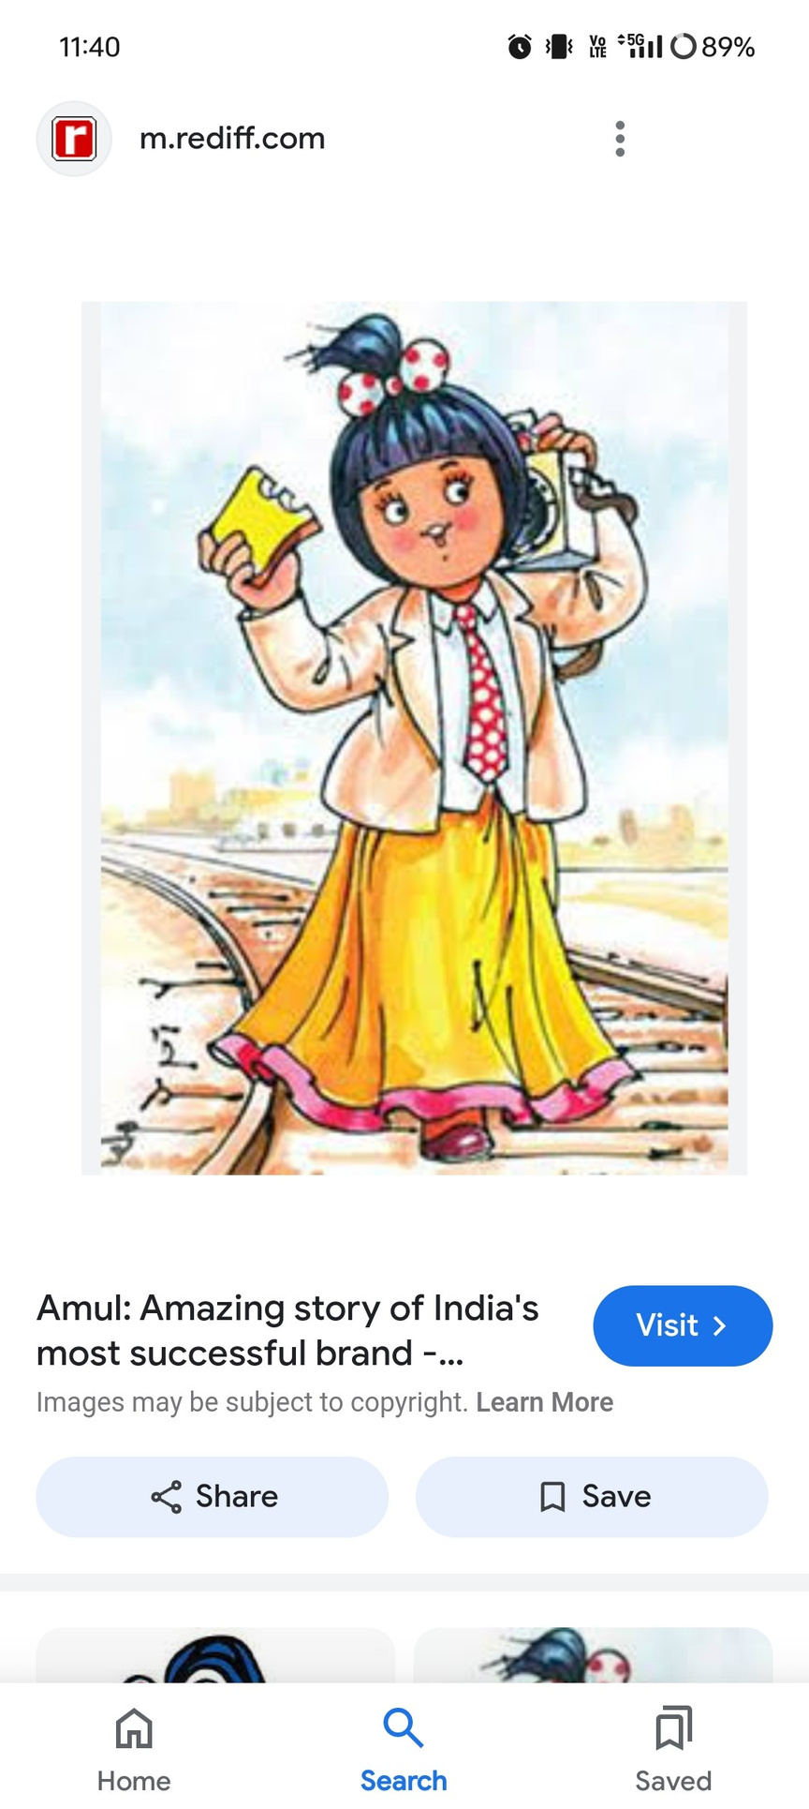

SEO Audit
An SEO Audit for Amul's website would involve analyzing various factors that contribute to the website's visibility, usability and performance on search engines like Here's a step-by-step breakdown of an SEO audit for Amul:
1.Technical SEO Analysis
•Site speed and performance
•Mobile friendliness
•Structured Data
3.Off-Page SEO Analysis
•Social media presence
•Backlink profile
•Local SEO
2.On-Page SEO Analysis
•Content Quality
•Keyword Optimization
•Image Optimization
4.Content strategy Analysis
5.Competitor Analysis
6.Analytics and Reporting
7.Recommendations & Action Plan

Slide 8



Keyword Research
Keyword Research is essential for understanding what terms and phrases potential customers are using to search for products and services related to Amul.Here's a structured approach to conducting keyword research for Amul:
1. Identifying core product categories
2. Seed keywords
3. Expanding keywords
4. Analyzing search intent
5. Competitor keyword Analysis
6. Long-tail keywords
7. Location based keywords
8. Content ideas based on keywords
9. Search volume & keyword difficulty
10. Keyword Mapping

Slide 9
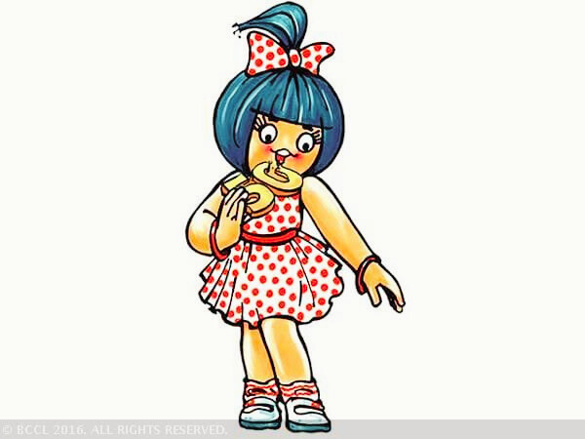



On Page Optimization
1. Keyword Research and Optimization
2. Content Quality and Relevance
3. URL Structure
4. Internal Linking
5. Image Optimization
6. Mobile-Friendliness
7. Technical SEO
8. User Experience (UX)
9. Analytics and Monitoring
10. Localization
Implementing these on-page SEO strategies can help Amul improve its online visibility, attract more traffic, and increase conversions.

Slide 10





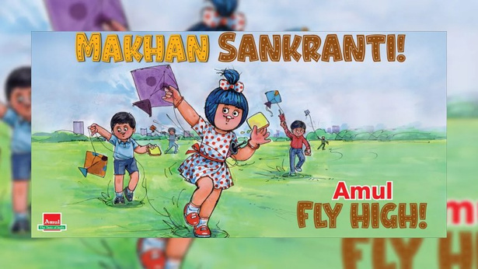
Content Idea Generation
Here are some content ideas that can resonate with different target audiences:
1. Product-Centric Content:
4. Educational Content:
•Recipe videos & blogs
•Product spotlight series
•Dairy facts
•How it's made
•Kid's corner
2. Health and Wellness:
5.Trending & Seasonal Content:
•Trending Topics
•Seasonal dairy Tips
•Collaborations with influencers
• Nutritional Benefits
• Dairy and fitness

Slide 11
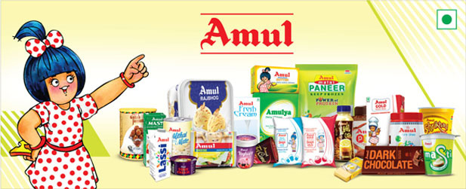
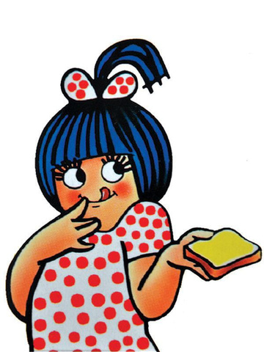


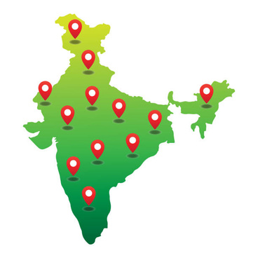
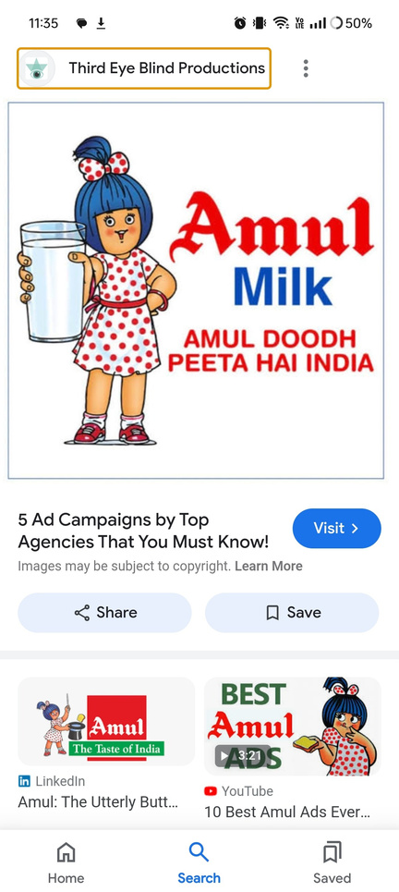


Marketing Strategies
Amul's marketing strategy has been one of the most successful and enduring in the Indian market.The brand has managed to stay relevant and beloved by millions through a mix of innovative advertising,strong brand positioning and deep consumer engagement. Here's an analysis of Amul's marketing strategy:
1. Brand Positioning: "The Taste Of India"
2. Product Diversification
3. Iconic Amul girl as mascot
4. Advertising & Branding
5. Digital & Social media strategy
6. Distribution strategy
7. Affordable Pricing strategy
8. Consumer engagement & feedback
9. Global expansion
10. 25% of Amul's advertising strategy
11. Moment marketing strategy

Slide 12

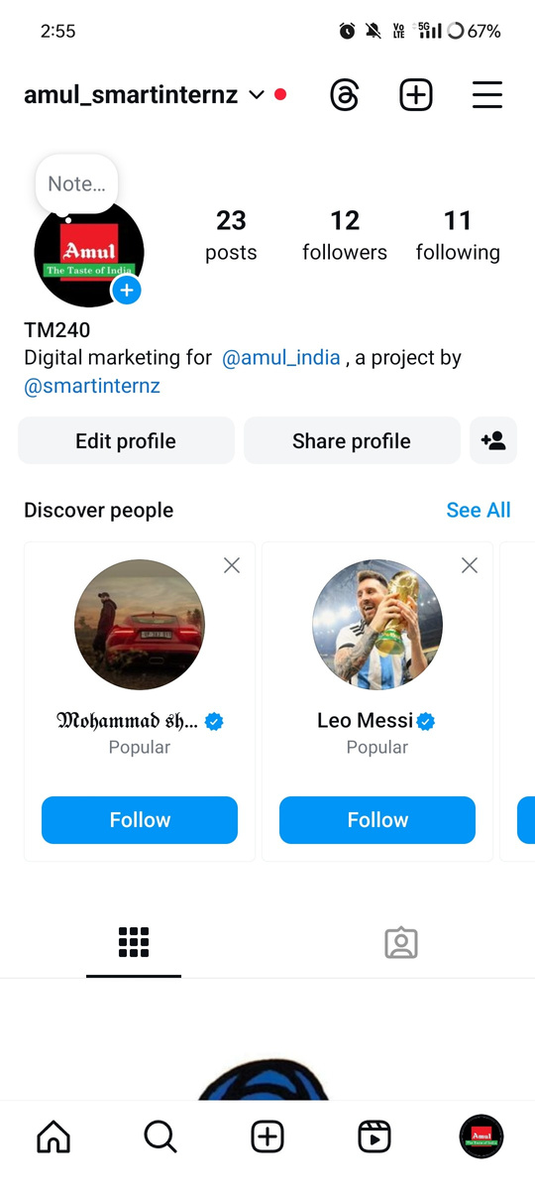
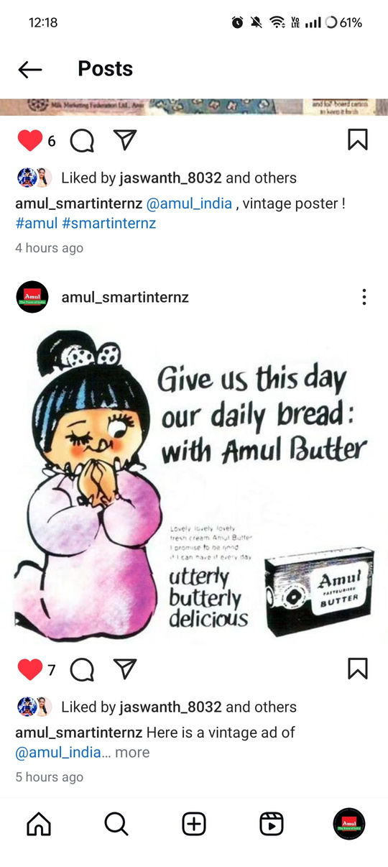
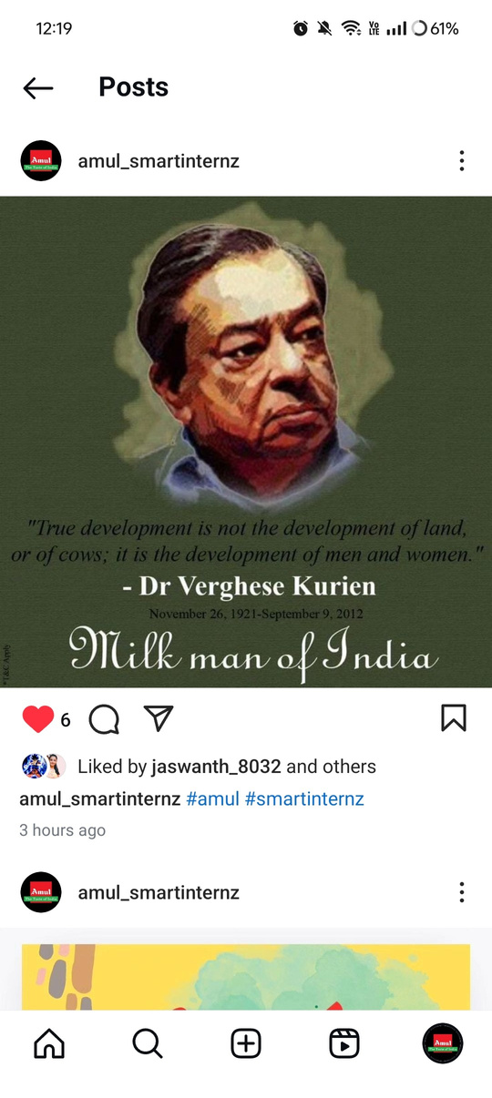

Post Creation
OBJECTIVE:
• Brand reinforcement
• Engagement & interaction
• Topical Marketing
• Promotion of products
• Building emotional connection
SIGNIFICANCE:
• Wider reach & visibility
• Real time engagement
• Viral potential
• Cost effective marketing
• Audience insights & feedback

Slide 13
Here's a link for Amul ad:
https://www.instagram.com/reel/C-9-HyFSOfz/?igsh=MWQ5eHA3OG5iMzYzNA==

Slide 14

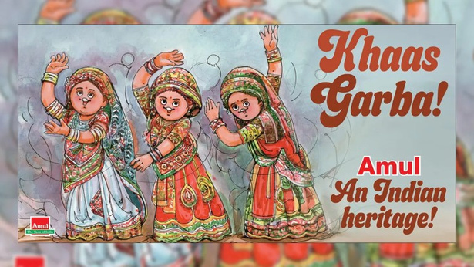

Social Media Ad Campaigns
Amul,the Indian dairy cooperative,is known for its creative and engaging social media ad campaigns. Amul's campaign #AmulTopical is an example of their digital marketing, where they create interactive content that's tailored to current events and trends.
•Topical Campaigns
Amul is famous for its topical advertising, where it quickly responds to current events, trends, or pop culture moments. These ads often feature the Amul girl, a cartoon character who delivers witty, pun-filled commentary on the latest news.
Amul girl celebrates Virat Kohli's 50th ODI century
Amul Topical captures the Anna seva by Anant Ambani and Radhika
Khaas garba after UNESCO adds the folk dance to the representative list
Amul girl celebrates India's joyous kite flying festival!

Slide 15

Email Ad Campaigns
Email ad campaigns are significant for Amul in several ways, particularly in enhancing their marketing strategy and deepening customer engagement. Here’s why they matter:
•Direct Communication with customers
•Cost-effective Marketing
•High engagement and conversion rates
•Personalized marketing
•Promotiom of new products & offers
•Driving traffic to digital platforms
•Brand recall and awareness
•Measurable results
•Supporting multi-channel marketing
•Educating consumers
•Crisis communication

Slide 16



Thank
you

